Slide 1
Image Processing Using Python
Unit-I (Part-II)
By
T.Vijaya Kumar
Assistant Professor

Slide 2
Contents
Color fundamentals,
Color image formats and conversion.
RGB Color Model
CMY & CMYK Color Model
HSI Color Model
Converting RGB to HSI Color Model
Converting HSI to RGB Color Model

Slide 3
Introduction

Slide 4
Introduction
4

Slide 5
Light
The colors that humans perceive in an object are determined
by the nature of the light reflected from the object.
Monochromatic light
Intensity
Chromatic light bands
Radiance (Watts-W)
Luminance (Lumens-lm)
Brightness

Slide 6
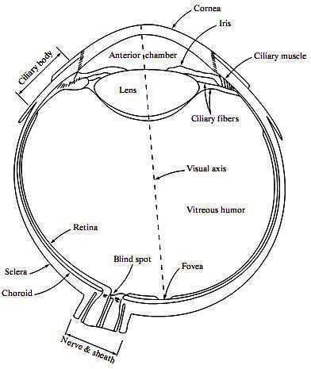
Light
6 to 7 million cones in the human eye can be divided into three principal sensing categories, corresponding roughly to red, green, and blue.
65%: red 33%: green 2%: blue (blue cones are the most sensitive)
6

Slide 7
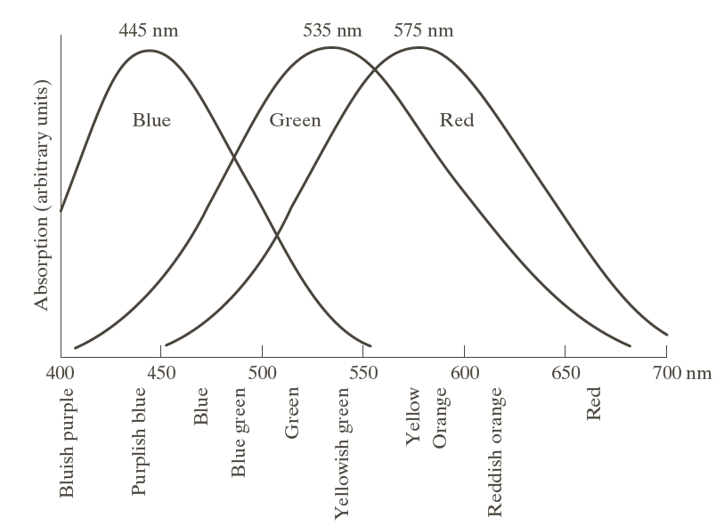
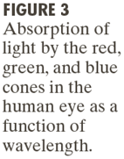
Light
7

Slide 8
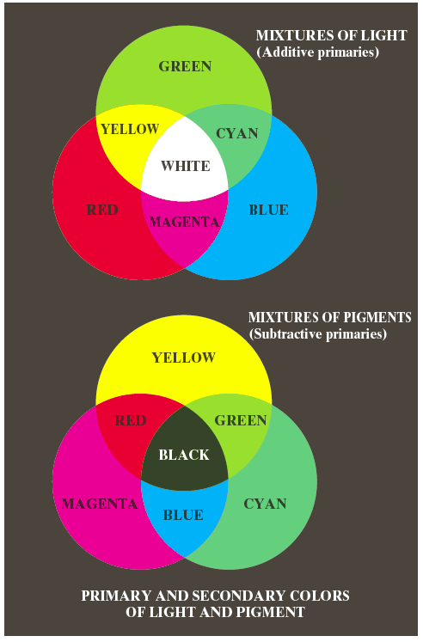
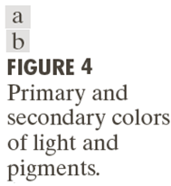
Primary and Secondary colors
8

Slide 9
Primary and Secondary colors
The characteristics generally used to distinguish one color from another are brightness, hue, and saturation
Brightness: the achromatic notion of intensity.
Hue: dominant wavelength in a mixture of light waves, represents dominant color as perceived by an observer.
Saturation: relative purity or the amount of white light mixed with its hue, with the degree of saturation being inversely proportional to the amount of white light added.
Ex: Pink (red and white),
Lavender (violet and white)
9

Slide 10
Primary and Secondary colors
Tristimulus
Red, green, and blue are denoted X, Y, and Z, respectively. A color is defined by its trichromatic coefficients, defined as
10

Slide 11
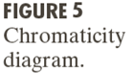
Primary and Secondary colors
It shows color composition as a function of x (red) and y (green)
11

Slide 12
Color Models & Conversion
RGB Color Model
CMY & CMYK Color Model
HSI Color Model
Converting RGB to HSI Color Model
Converting HSI to RGB Color Model

Slide 13
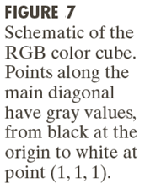
RGB Color Model
13

Slide 14

RGB Color Model
Pixel depth
The total number of colors in a 24-bit RGB image is (2⁸)³ = 16,777,216
14

Slide 15
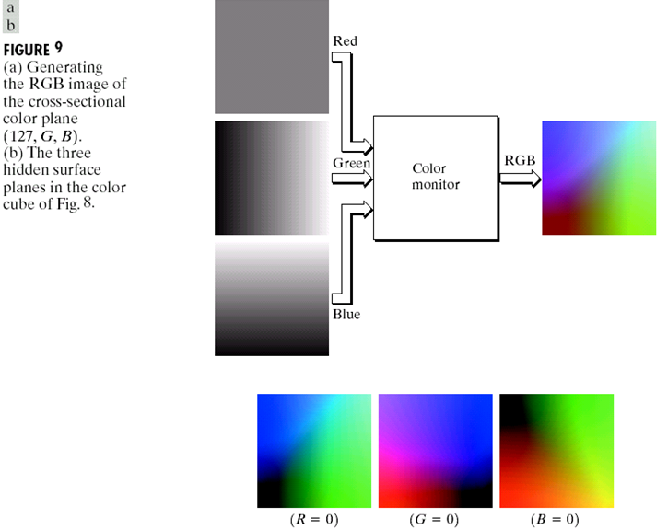
RGB Color Model
15

Slide 16
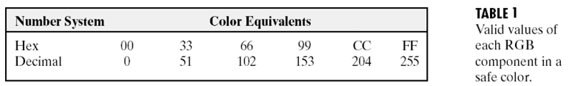
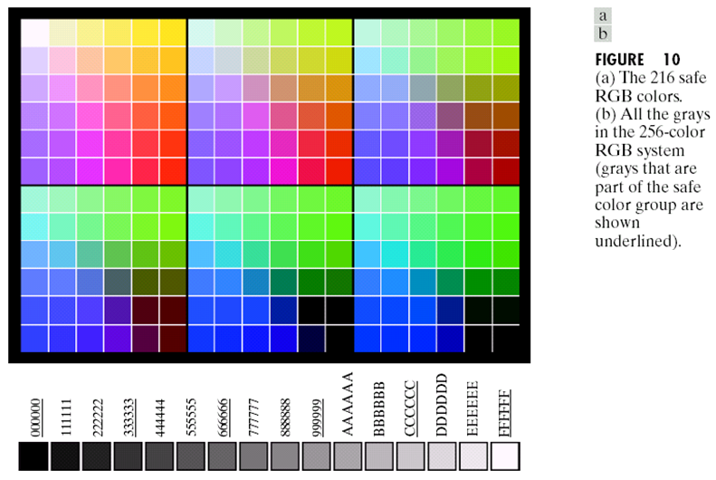

Slide 17
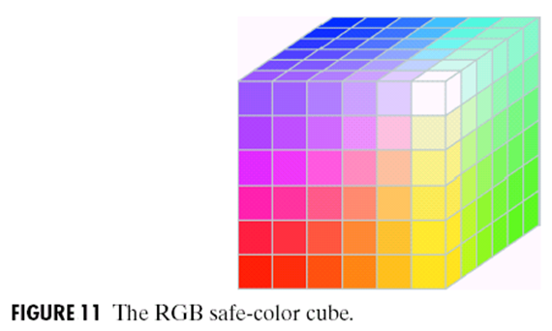
RGB Color Model
Safe RGB colors (or safe Web colors) are reproduced faithfully, reasonably independently of viewer hardware capabilities
17

Slide 18
The CMY and CMYK Color Models
Equal amounts of the pigment primaries, cyan, magenta, and yellow should produce black. In practice, combining these colors for printing produces a muddy-looking black.
To produce true black, the predominant color in printing, the fourth color, black, is added, giving rise to the CMYK color model.
18

Slide 19
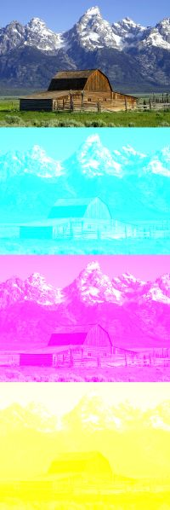
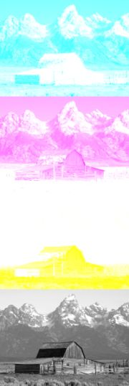
The CMY and CMYK Color Models
CMY vs. CMYK

Slide 20
HSI Color Model
Hue: dominant wavelength in a mixture of light waves, represents dominant color as perceived by an observer.
Saturation: relative purity or the amount of white light mixed with its hue.
brightness: the achromatic notion of Intensity.
20

Slide 21
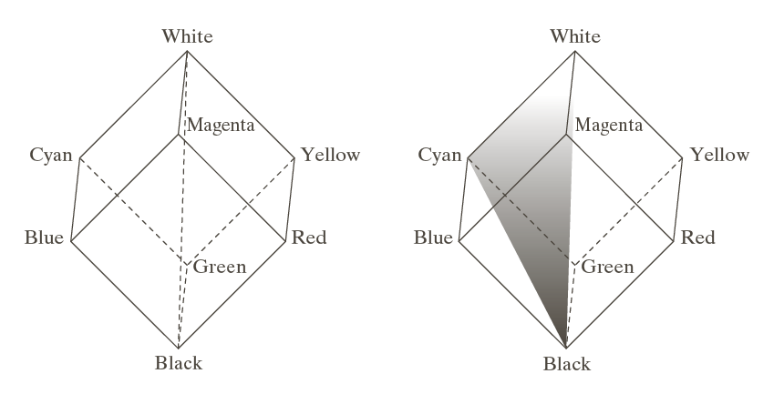
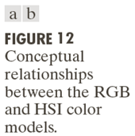
HSI Color Model
21

Slide 22
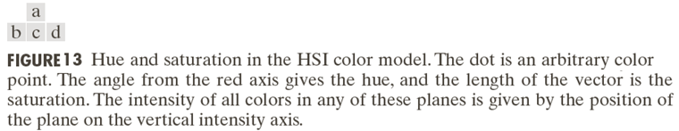

Slide 23
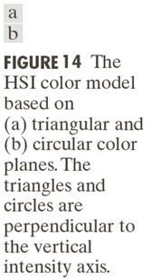

Slide 24
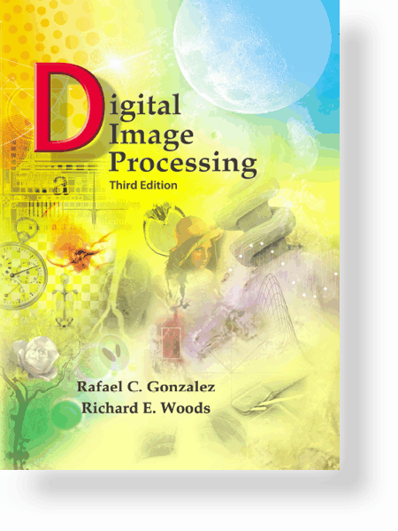
UNIT – I: Color Image Processing
Converting Colors from RGB to HSI
Given an image in RGB color format, the H component of each RGB pixel is obtained using the equation
24

Slide 25
UNIT – I: Color Image Processing
Contd…
Given an image in RGB color format, the saturation component is given by
Given an image in RGB color format, the intensity component is given by
25

Slide 26
UNIT – I: Color Image Processing
Converting Colors from HSI to RGB
RG sector
26

Slide 27
UNIT – I: Color Image Processing
Contd…
RG sector
27

Slide 28
UNIT – I: Color Image Processing
Contd…
RG sector
28

Slide 29
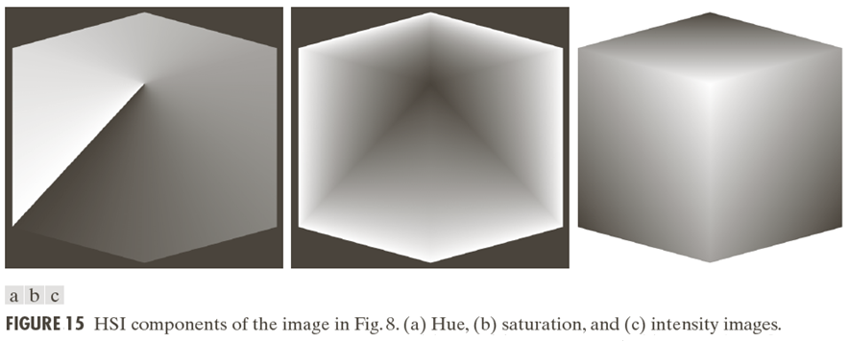

Slide 30
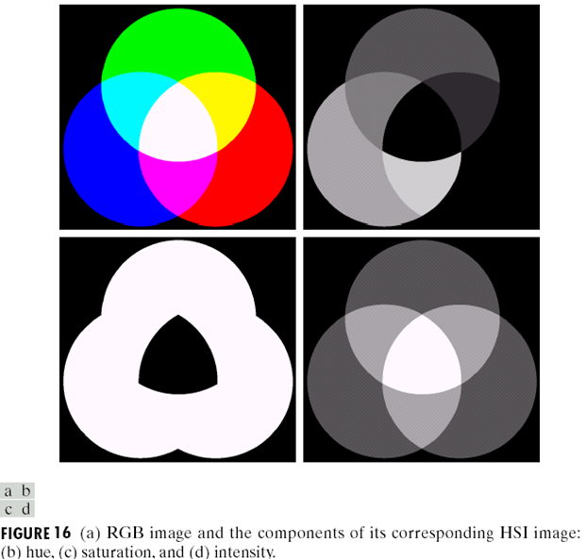

Slide 31
